Slide 1

Gatsby-Kaken Joint Workshop on AI and Neuroscience
May 12, 2017
Brain-inspired AI as a way to desired general intelligence
Hiroshi Yamakawa* Naoya Arakawa* Koichi Takahashi*
The Whole Brain Architecture Initiative， a specified non-profit organization
http://wba-initiative.org/

Slide 2
Today’s talk
Self-introduction
Whole brain architecture
Brain-inspired AI in harmony with humanity
Conclusions

Slide 3
Today’s talk
Self-introduction
Whole brain architecture
Brain-inspired AI in harmony with humanity
Conclusions

Slide 4
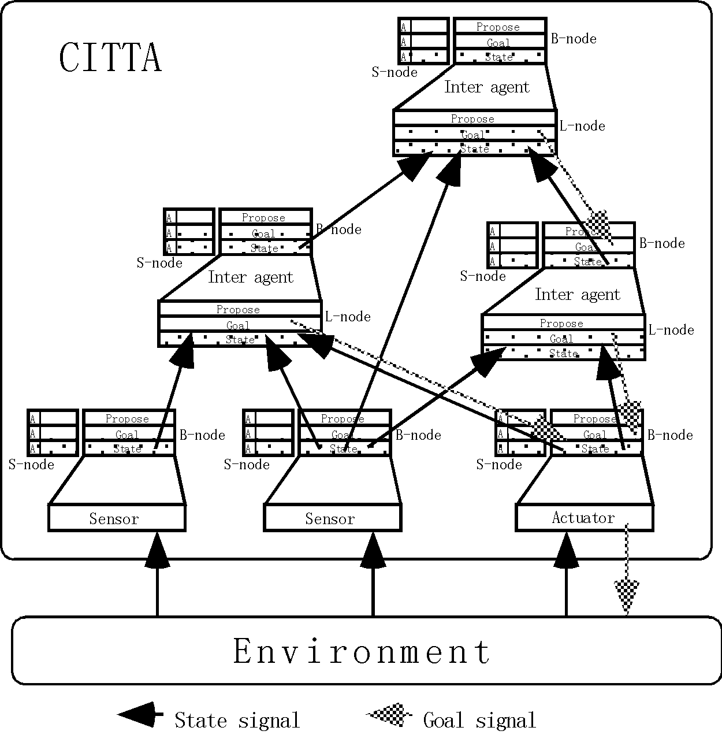
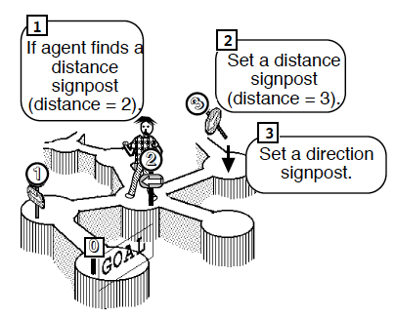
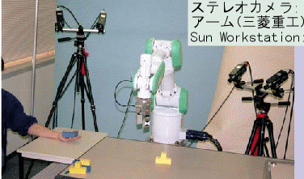
RL+DL was my dream in 1990’s
Intelligent system based on reinforcement learning - A study on pattern processing intelligent machine using value system -
Cognition based intelligent transaction architecture : CITTA
RL
Doctoral thesis, 1992
Hierarchical information integration model using unsupervised autoencoder
Hand-to-Hand Robot
DL
H. Yamakawa, et. al, 1995
Suehiro, T., Takahashi, H., Yamakawa, H.(1997)
https://goo.gl/qISkoG
Notes:
http://hymkw.com/researches/MACC97/poster-menu-e.htm

Slide 5

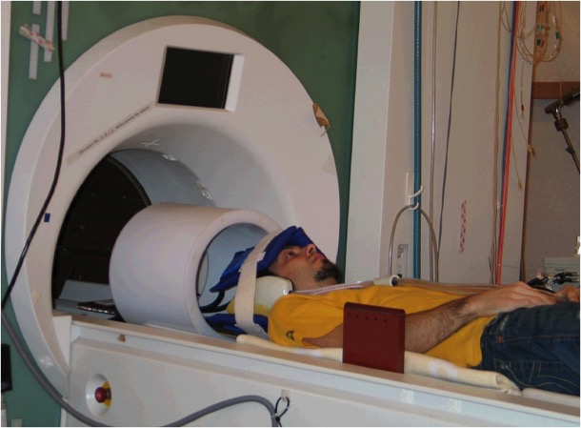
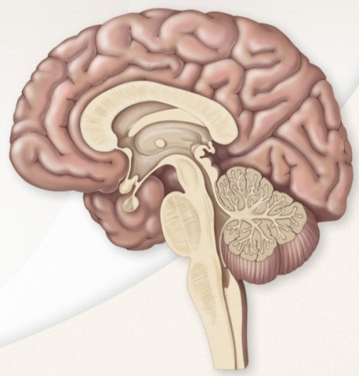
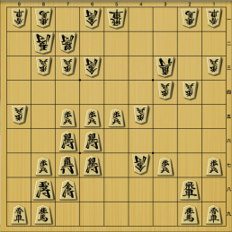
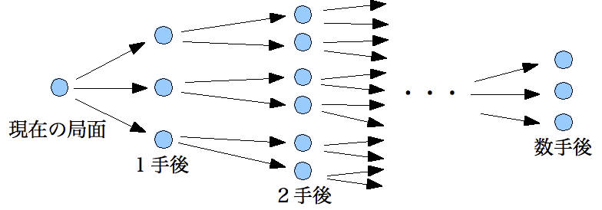
直感力を実現した深層学習
Caudate nucleus
Select next move
Precuneus
Understand situations
MTG
/V6
2007-2011
Convolution
DL
V3
RL
Convolution
V2
Convolution
V1
Eye
V1
Convolution
Xiaohong Wan, et. al., Science, 2011
Neural basis of intuitive best next-move generation in board game experts.
①Understand
②Intuition
③Validation
※ FUJITSU ltd. supports this project
and I provide them technical advice on AI.
Notes:
Then we elucidate that experts’ basal ganglia are activated for intuitive next-move, and experts are acquiring special representation on the neocortex to support that ability through long-term training.
現状の計算機は，強力な論理思考で網羅的に読んで局面評価．
これに対して，エキスパートを仮説を立ててから検証する．
盤面を見た時にプロ棋士で特異的に活動したのが楔前部．ここに直観を支える特徴量が存在すると考えられる．
Then we elucidate that experts’ caudate are activated for intuitive next-move, and experts are acquiring special representation on the neocortex to support that ability through long term training.

Slide 6
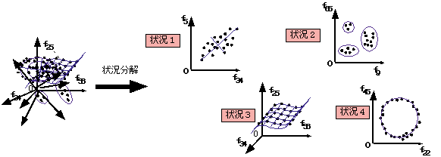
SD (Situation decomposition) method
The SD method extracts multiple situations, each of which is a pair of ‘subset of feature’ and ‘subset of events’ containing each rule, from relational data.
(Yamakawa, 1998)
Situation
2
Situation
1
SD
Situation
3
Situation
4
Multidimensional data in which multiple situations are intertwined
Criterion to select situations based on matchable principle
Simplicity
of Model
Matchable principal
Ockham’s razor
Increase events
Increase inside dependency
Decrease dependency from outside
Coverage
for Data
Consistency
for Data
A: subset of feature, C: subset of events

Slide 7
EcSIA: Desirable future coexisting with AI
In a desirable future, the happiness of all humans will be balanced against the survival of humankind under the purview of a superintelligence. In that future, society will be an ecosystem formed by augmented human beings and various public AIs, in what I term an ecosystem of shared intelligent agents (EcSIA).
Although no human can completely understand EcSIA—it is too complex and vast—humans can control its basic directions. In implementing such a control, the grace and wealth that EcSIA affords needs to be properly distributed to everyone.
（Hiroshi Yamakawa, July 2015)

Slide 8
Today’s talk
Self-introduction
Whole brain architecture
Brain-inspired AI in harmony with humanity
Conclusions

Slide 9
Artificial general intelligence (AGI)
Execution systems are similar
Versatility is increased gradually
Narrow AIs are mature
Operate intelligently within particular domains
Machine learning for enough data domain
Many systems with capabilities exceeding those of humans have already been implemented
AGI is the technological goal
Learning problem-solving in multiple domains
Can solve unexpected problems when appropriately designed
Data sparseness problem
Self-awareness / autonomous self-control
R&D process is different.
The difference between machine learning studies and knowledge engineering.

Slide 10
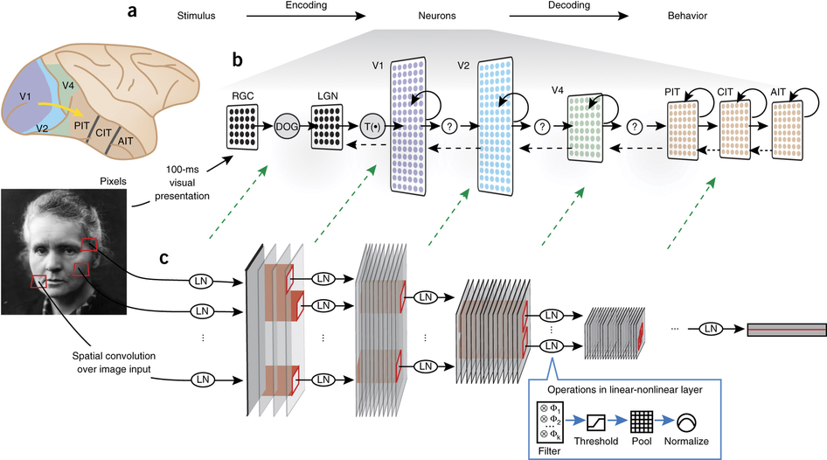
Visual temporal lobe pathway and CNN
The neural activity of the neocortex is homologous to the activity of learned CNN. Nevertheless, the intermediate area cannot be understandable. Naturally it can not be designed.
Yamins and DiCarlo,
Nat Neurosci.19:356-65, 2016
Notes:
Meanwhile, from the viewpoint of AI drawing on the brain, the realization of AGI does not seem so far away, as brain functions have been partially realized with artificial neural networks (ANNs).
For example, general object reninition with a convolutional neural network (CNN) can be used to model the visual temporal lobe pathway
the delayed reward calculation of reinforcement learning for the basal ganglia.
auditory cortex and cerebellum.
Those functional models will be gradually integrated to the whole brain architecture with mesoscopic connectomic information
新皮質の神経活動は学習済みのANNの活動と相同する。
それでも、中間領域は意味づけできず、当然設計もできない

Slide 11
DL opens the door to HLAI realization
A functional model of the neocortex has been created by an artificial neural network (ANN)
  One of the next big barrier in modeling is the hippocampal formation and its peripheral connections.
We believe that the ANN granularity is enough to implement computational function of brain organs.
The infant AI was realized
  Integration with adult AI is the next step.
DL is an excellent engine of AI, but it is not a car.
The design drawing of a car is necessary for AGI.
Notes:
しかしDLはAIのエンジンであって車ではない

Slide 12
Adult AI vs. Infant AI
Adult AI
Understandable
Designed
Deduction
Basic elements of AI come together
Integration of elements is necessary
Birth of the computer
Realize human-level AGI
Increasing computational resources
Infant AI
Not understandable
Machine learning
  Need computational resources
Induction
1956
1976
1996
2016
202X年
Notes:
With the advent of deep learning, Moravec’s paradox began to be eliminated and the current AI is progressing in a bottom-up approach following the ways of phylogeny and ontogeny.
However, it is still struggling with intuitive physics that can be grasped by less-than-a-year-old infants. From this viewpoint, the realization of AGI seems far away.

Slide 13
Unsolved core issues in AI after DL
General intelligence
Versatility: Shortage of data due to expansion of scope
Problem solving in a realistic period: Lack of sufficient data collection time
This is an
OLD & Unsolved
issue
Data sparseness problem
Architecture for integration
One/zero-shot learning
Introduce deduction
Acquired domain knowledge is mapped to an unknown domain or it expanded the scope
Transfer learning /
Multi-task learning/ Domain adaptation
Decompose distributed representation
Disentangle,
Etc.
How to effectively use the knowledge (representation) acquired by inductive learning
Notes:
本質的に関連している。
知能の汎用化を目指してタスクの適用範囲を広げてゆけば、必要とされるデータ増大するが、そこで一定のタスクに対してあらたにデータを収集するほどの時間的余裕がないときが問題となる。
こうした状況では、必然的にデータが不足するために、帰納推論によって良い性能は得られない。そこで、演繹やアブダクションのような大人の知能が必要となる。

Slide 14
Cognitive architecture
A fixed design drawing (not a learning part) depicts the arrangement of components constituting intelligent agents (animals and machines)
Implement real-time integration of recognition and behavior
Through interactions of components, it is possible to respond flexibly to unexpected situations → AGI
Cognitive architecture is an important concept for building intelligence,
but few discussions exist on in neuroscience.
Connectome etc. give hints to construct cognitive architectures.
Notes:
知的エージェント(動物や機械)を構成するコンポーネントの配置を描いた固定的な設計図（学習部分ではない）．
認識行動のリアルタイムな挙動を統合的に実装する．
コンポーネントの組合せ(相互作用）を通じて，予期しない／未知の事態への柔軟な対応が可能である
AI分野の重要概念だが、神経科学での議論は少なかった。しかしコネクトーム等からから学びうるもの

Slide 15
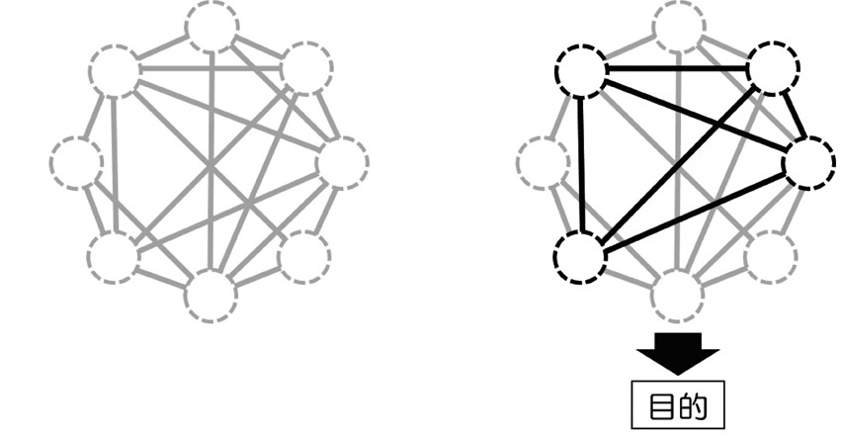
Architecture to integrate distribution & concentration
Distribute individual functional modules over the whole brain network
Utilize necessary functional modules according to each purpose
Purpose
Hiroshi Okamoto、Whole-Brain Network Analysis : Approaching the Whole-Brain Architecture by Complex Network Analysis of Human Connectome [in Japanese], 2016.
Notes:
岡本 洋、全脳ネットワーク分析：複雑ネットワーク科学とコネクトームとの融合から全脳アーキテクチャにせまる、情知報能（と日情本報知（能日情本報知フ能ァ情ジ報ィフ学ァ会ジ誌ィ）学会誌）Vo.28, No.2, pp.28－ 37（2016）。
＊1，2

Slide 16
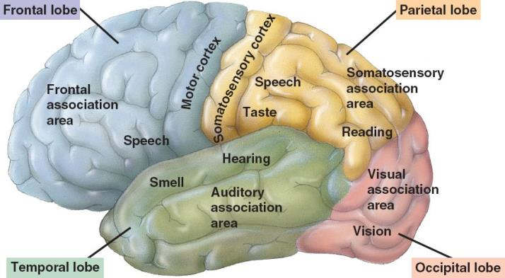
Uniformity of the neocortex is the basis for its versatility
Bodily-kinesthetic
Verbal-linguistic
Logical-mathematical
Musical-rhythmic and harmonic
Interpersonal
Intrapersonal
Visual-spatial
図の出典： http://bio1152.nicerweb.com/Locked/media/ch48/48_27HumanCerebralCortex.jpg
Uniform mechanism induces learning of various functions ー＞ support general intelligence
  Realized in the neocortex
  Machine learning (deep learning)
Notes:
1.1 Musical-rhythmic and harmonic
1.2 Visual-spatial
1.3 Verbal-linguistic
1.4 Logical-mathematical
1.5 Bodily-kinesthetic
1.6 Interpersonal
1.7 Intrapersonal
1.8 Naturalistic
1.9 Existential
機能的多様性 vs. 解剖学的一様性
脳機能を再現する理解からのアプローチはAI有望なのか
知能に関わる主要な脳器官は少なく，なおかつ計算理論に目処がたちつつある器官が多い．
小脳はフィードフォワード制御，大脳基底核は強化学習など
新皮質によるほぼ同じ計算処理から多種多様な知性が生まれている．
AI研究者からはシンボル処理は早晩には解明されないとの反論が多いが，脳科学からみれば言語野であっても視覚野や聴覚野と特段に異なる処理をしているとは考えにくい．
全脳アーキ(WBA)は全脳エミュレーション(WBE)よりも早い
WBEは分子レベルでの脳理解を要するので，スキャナー性能が上がるまで待たなければいけないが，WBAはすぐに取り掛かれる．

Slide 17
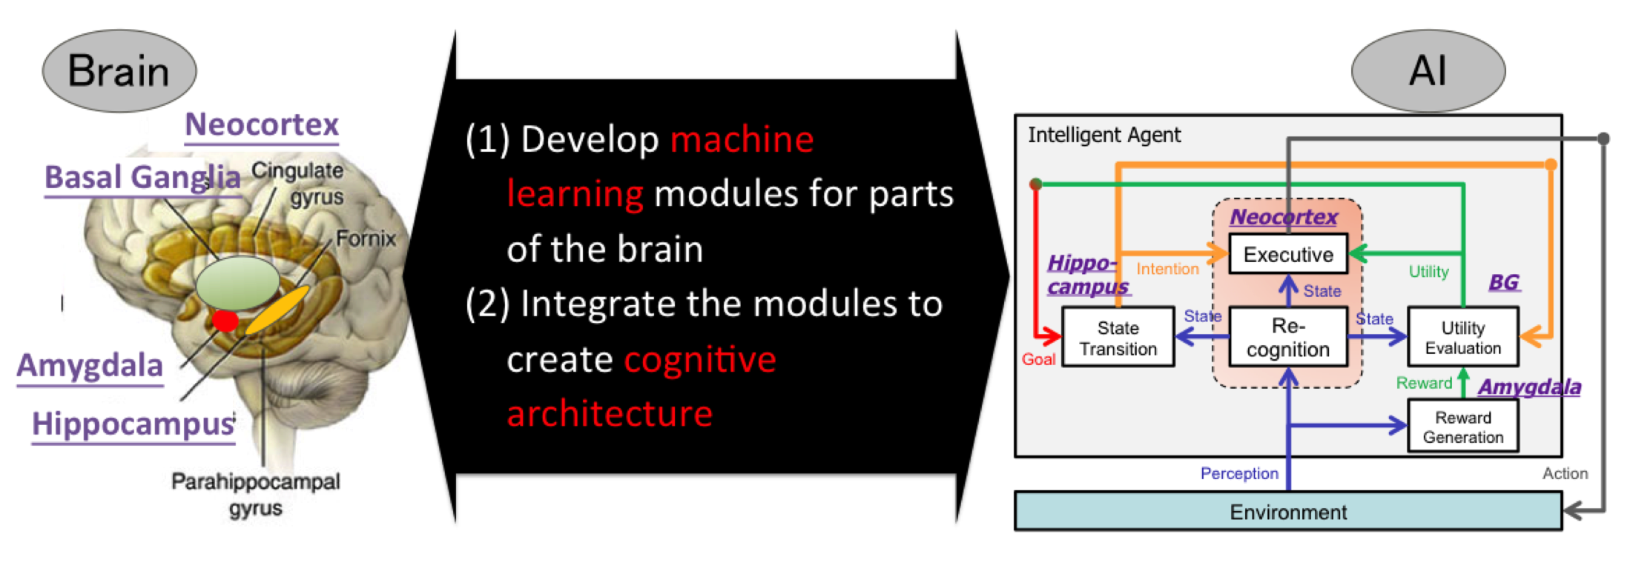
Whole Brain Architecture approach
‘to create a human-like AGI by learning from the architecture of the entire brain’
  We gradually adopt the detailed model as needed, to reach the AGI finally

Slide 18
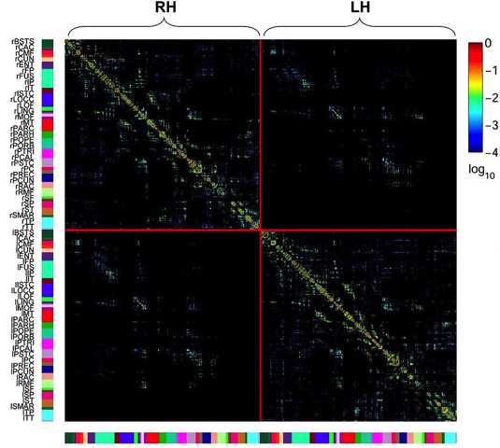
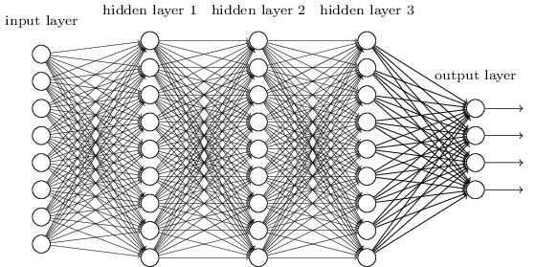
What makes this approach feasible?
  Whole brain architecture
  ＝ ML＋ cognitive architecture
  Deep neural networks can be neocortex models that was big wall
Mesoscopic connectome can be an architecture for combining ML
Notes:
Until recently, there was a technological difficulty in both tasks, but it has become an increasingly possible approach in recent years because of the following background:
(1) The neocortex has a large role in the versatility of the brain; however, researchers have had success with deep learning studies in recent years, which could be seen as a model for neocortex.
(2) Overall brain connection manner (connectome) can be seen as a model for constructing the cognitive architecture for the flexible combination of machine learning [5]. A connectome includes static nerve connection structure [6] and also dynamic nerve activity connectivity during task execution and resting states.

Slide 19
Finding Architecture & Adaptive structure
Theory
(Mathematics, Information theory, etc.）
Environment/Data (Simulation)
Search
Domain knowledge
Natural intelligence
Evolutionary computing
Machine learning
Neuroscience
Prototyping
Design
based on understanding
Imitation
without understanding
Intelligent agent
Architecture
Adaptive structure
Notes:
目的が多様なAGIでは、機能に基づいた設計ができない

Slide 20
Finding Architecture & Adaptive structure
Theory
(Mathematics, Information theory, etc.）
Environment/Data (Simulation)
Search
☓
Domain knowledge
Natural intelligence
Evolutionary computing
Machine learning
Neuroscience
Prototyping
Design
based on understanding
Imitation
without understanding
Intelligent agent
Architecture
Adaptive structure
Notes:
目的が多様なAGIでは、機能に基づいた設計ができない

Slide 21
Finding Architecture & Adaptive structure
Theory
(Mathematics, Information theory, etc.）
Environment/Data (Simulation)
Search
☓
Domain knowledge
Natural intelligence
Evolutionary computing
Machine learning
Neuroscience
Prototyping
Design
based on understanding
Imitation
without understanding
Intelligent agent
Architecture
Adaptive structure
Notes:
目的が多様なAGIでは、機能に基づいた設計ができない

Slide 22
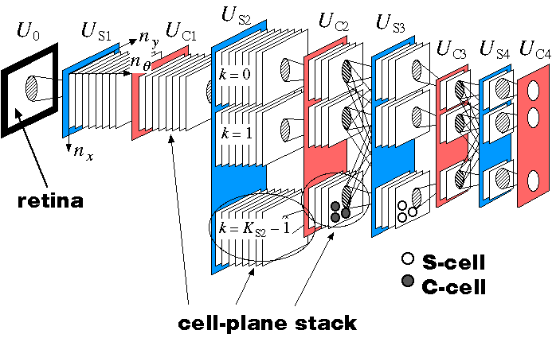
Expanding success of neocognitron
General object recognition is realized after
Neocognitron
What we learned from brain are
To realize AGI we need
Whole Brain Architecture
What we should learn from brain are
Canonical cortical unit for recognition with simple and complex cells
Canonical cortical unit including other functions, such as attention and action generation
Hierarchical architecture
Architecture based on a mesoscopic connectome (include a sub-cortical system)

Slide 23
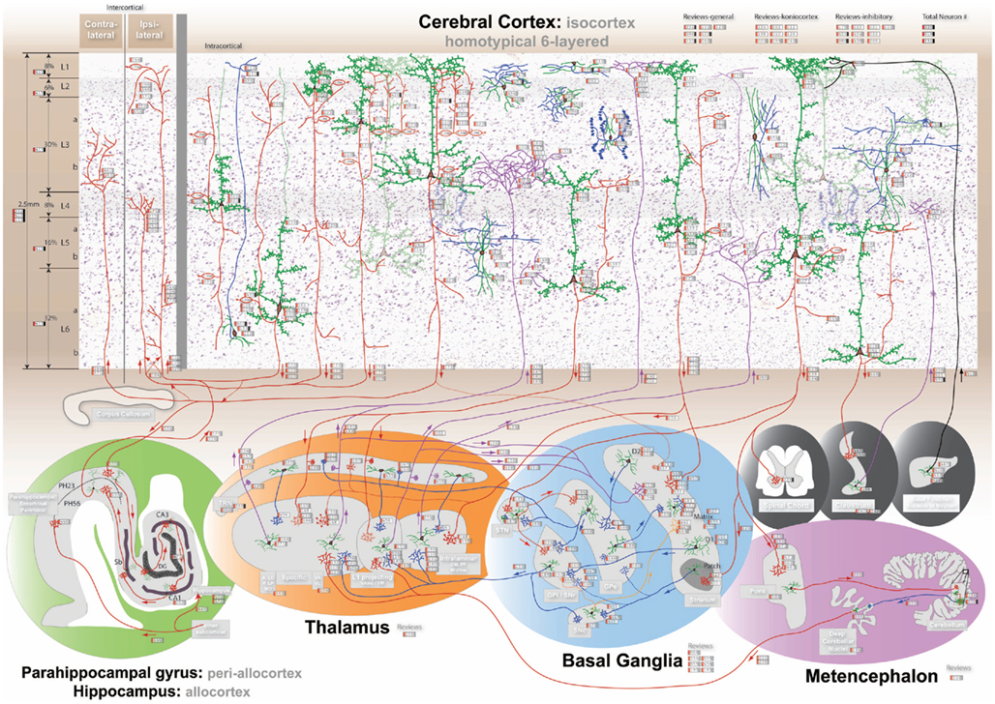
Framework is important to develop WBA
Canonical cortical circuits
Mesoscopic connectome
Sub-cortical model (hippocampus, thalamus, basal ganglia)
http://www.frontiersin.org/files/cognitiveconsilience/index.html

Slide 24
Reinterpretation of cortical circuits
An attempt to describe a ‘canonical cortical circuit’ with words understandable by machine learning experts
Input
Signal Semantics
Neocortex
Signal Semantics
Output
Input 1
L1
Output 1
Control (Attention, context, etc.)
Control (Attention, context, etc.)
Lower L6,
Lower L1
Higher L6
L6
Activity control
Input 2
Output 2
(Basal ganglia-controlled) Thalamus
Hidden state output control
Hidden state [Action output]
Basal ganglia, [Pyramidal tracts]
L5
Input 3
Output 3
Higher L2/3, Hippocampus, Cerebellum
State
(top down)
State
Lower L2/3
L2/3
Input 4
Lower L2/3
State (bottom up)
Higher
L2/3 or L4, Hippocampus
L4
Input 5
Information selection (attention)
(Lower L5 origin) Thalamus
Hidden sate (bottom up)
Thalamus
Canonical cortical circuits
(Yamakawa et. al., IJCAI WS 2017, submitted)

Slide 25
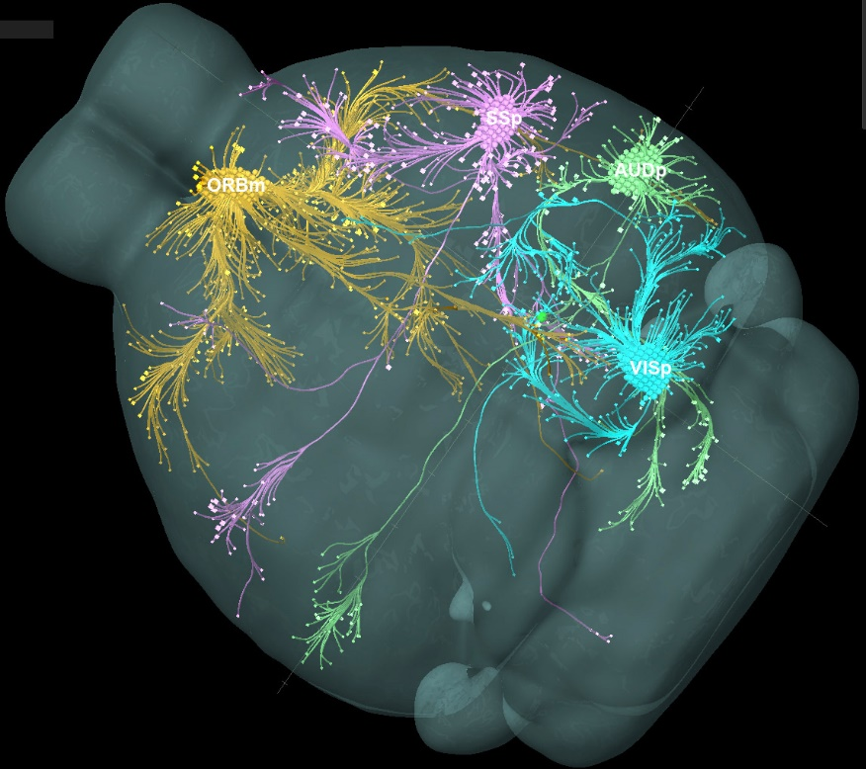
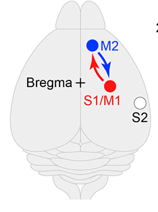
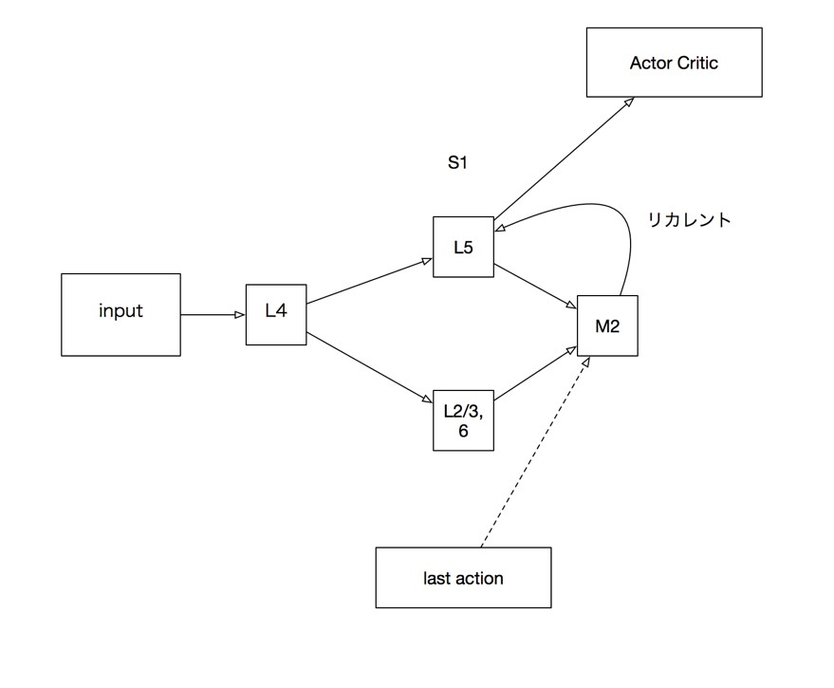
Integrate ML modules on connectome
Mesoscopic connectome
Whole Brain Connectomic Architecture (WBCA) Program
ex)
Motor-Sensory
Neural Circuit
(Manita S, …, Murayama M, A Top-Down Cortical Circuit for Accurate Sensory Perception, Neuron, 2015)
Network
Architecture
Modeling
By Engineer
Recurrent
Network
WBCA is a static architecture based on information about connectomic network topology.
WBCA is platform to integrate ML modules to build AGI.
Artificial network design from biological connectomes
(Mizutani, Arakawa, Ueno, Yamakawa, BiCA2017)
Notes:
機械学習の組み合わパターンは膨大であるため、それを統合するアーキテクチャとして唯一存在する脳を参考にするのは妥当かつ協力を得やすい。
For constraining enormous combination patterns of MLs, WBCA is reasonable as integration platform to build AGI.
(Manita S, …, Murayama M, A Top-Down Cortical Circuit for Accurate Sensory Perception, Neuron, 2015)
Satoshi Manita10,
Miyamoto D, …, Murayama M., Science, Top-down cortical input during NREM sleep consolidates perceptual memory. 2016.

Slide 26
Integrate ML modules on connectome
Mesoscopic connectome
Whole Brain Connectomic Architecture (WBCA) Program
Need architecture to reduce enormous combination patterns of MLs.
The architecture of the brain,
as uniquely existing AGI, is reasonable as integration platform.
ex)
Motor-Sensory
Neural Circuit
Network
Architecture
Modeling
By Engineer
Recurrent
Network
WBCA is a static architecture based on information about connectomic network topology.
WBCA is platform to integrate ML modules to build AGI.
Artificial network design from biological connectomes
(Mizutani, Arakawa, Ueno, Yamakawa, BiCA2017)
Notes:
機械学習の組み合わパターンは膨大であるため、それを統合するアーキテクチャとして唯一存在する脳を参考にするのは妥当かつ協力を得やすい。
For constraining enormous combination patterns of MLs, WBCA is reasonable as integration platform to build AGI.

Slide 27
Reinterpretation of hippocampal formation
Sub-cortical model
HP
ParaSb
HD, B, P, G, Band-like
Global goal state
PreSb
Mammillary bodies, ATN of thalamus
HD, B,P, G
Abstraction of intention
Abstraction of intention
EC(MEC/LEC)
Coordinate transformation
Global current state (MEC only)
HD
Ⅴ&Ⅵ
HD,B,G
Deep
Deep
HD, B, P
Sb
Generate
intention
Self-position estimation
Nucleus accumbens,
Medial septum
CA1
Ⅲ
P
HD,B,G
Current state
Shallow
Shallow
Generate intention sequence
CA3
B,G
Ⅱ
Goal state
P
Shallow
Shallow
Recurrent network
PER/POR
Unimodal/
Polymodal Ctx
Medial septum
MC
P
GC
State prediction error
Pattern separation
Newborn cell
Spatial depended cell
(※ Notation in EC exists only in MEC)
HD: Head-direction cell, B： Border cell, G: Grid cell, P: Place cell
(Yamakawa, JSAI 2015)
Notes:
図1： 海馬−嗅内皮質の興奮性神経細胞による主要な神経回路
HP: Hippocampus (海馬), EC：Entorhinal Cortex(嗅内皮質)（MECは内側，LECは外側），GC：Granule Cell (顆粒細胞), MC: Mossy Cell (苔状細胞), Sb: Subiculum (海馬台), ParaSb: Parasubiculum (傍海馬台), PreSb: Presubiculum (前海馬台), Perirhinal Cortex (嗅周囲皮質), Postrhinal Cortex (嗅後部皮質), Mammillary bodies (乳頭体), Anterior nuclei of thalamus (視床前核), Nucleus acumens (側坐核), Medial septum (内側中隔核), 赤い矢印でトリシナプス回路を示した．

Slide 28
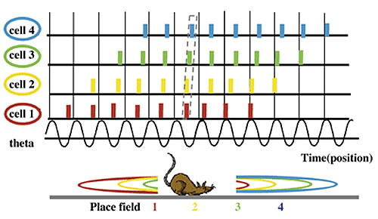


ES (equivalent structure) extraction inspired by HCF
A technique of extracting sets of tuples (ES’s) that can be regarded as mutually equivalent, from multidimensional series of data
Input: sequences
Output: Sets of tuples (ES’s)
Equivalent with some similarity function
(Stao, Yamakawa, IJCNN 2017)
Theta phase precession in HCF (Hippocampal Formation)
Several sequential events are packed in each phase (~5 Hz)
Inspiration
( Sato and Yamaguchi : Neural Computation 2003)
Notes:
新皮質と海馬を統合した機能モデルの可能性も見え始めている
Subspaces can be compared using local sequences
A technique of extracting pairs (or sets) of feature amount sets that can be regarded as mutually equivalent, from multidimensional series data.

Slide 29
Today’s talk
Self-introduction
Whole brain architecture
Brain-inspired AI in harmony with humanity
Conclusions

Slide 30
Abilities of AGI
Development costs are lower than narrow AIs: Disruptive innovation
Versatile
Learning various problem-solving capabilities
Generalist AI: (1) Make decision by integrating a diverse specialist
(2) Communicating with each specific user using wide range of of topics
Autonomy
Exploring the world without being under others' control
Robustness: Can handle exceptional situations
Creativity: Creates hypotheses and understands the universe
Notes:
■AGIは何をもたらすのか
汎用性＋自律性→創造性
執事ロボットからAIサイエンティストへ
ホモ‐ルーデンス（〈ラテン〉Homo ludens）
《遊ぶ人の意》人間観の一。遊ぶことに人間の本質的機能を認める立場から人間を規定した言葉。オランダの歴史家ホイジンガが提唱した。

Slide 31
Emergence of AGI (creative intelligence)
After singularity
Recursive Self-Improvement
Before singularity
Design by humans is
the rate limiting step
Design
AGI
Technology
Design
Technology
Level of intelligence
Human
Design
AI
Year
Change of protagonists
Recursive Self-Improvement: AI systems designed to recursively self-improve or self-replicate in a manner that could lead to rapidly increasing quality or quantity must be subject to strict safety and control measures.
(ASILOMAR AI PRINCIPLES : 22)
Notes:
http://keima.la.coocan.jp/rwcp/10years/10-2/docs/chapter007/3para/01/yamakawa.html
It is critical to give artificial intelligence (AI) a general purpose
problem-solving ability, as artificial general intelligence (AGI) with such functionality will bring about unprecedented intelligence development by its self-improvement capability.

Slide 32


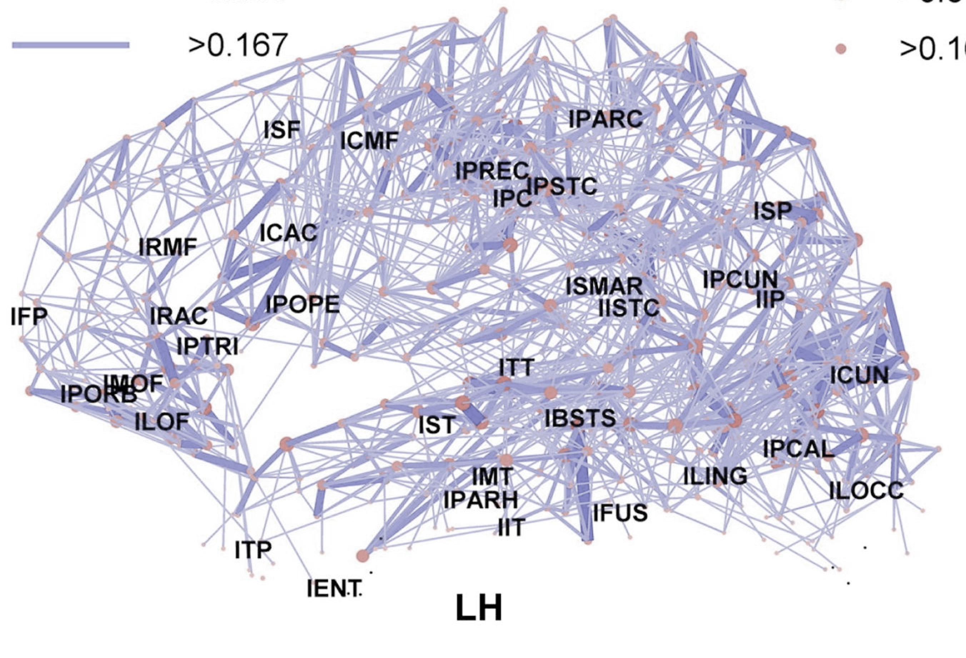
WBAI, non-profit organization (Since 2015)
Charter
Open community development of AGI
Long-lasting:
Target 2030
Promoting cooperation with related disciplines:
Developing multidiscipline human resources
R&D for WBA developmental environment
Advisers:
Kenji Doya (OIST),
Hiroaki Kitano (Sony CSL),
Masaru Tomita (Keio Univ.),
Hiroyuki Morikawa (Tokyo Univ.),
Hideyuki Nakashima (Tokyo Univ.)
Let’s build brain together

Slide 33

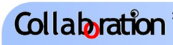
























We promote open co-creation of AGI on Brain
R&D teams
K. Doya, et. al.
T. Taniguchi, et. al.
K. Takahashi, et. al.
Promote R&D
Construction of the development environment
World simulator
Evaluation of AGI
Platform for integration (BriCA) Poster Takahashi
Grounding to brain
Human resource development
Hackathon
Seminar
School
Supports
Toshio Okubo
Kentaro Goto
Ren Sakaki

Slide 34
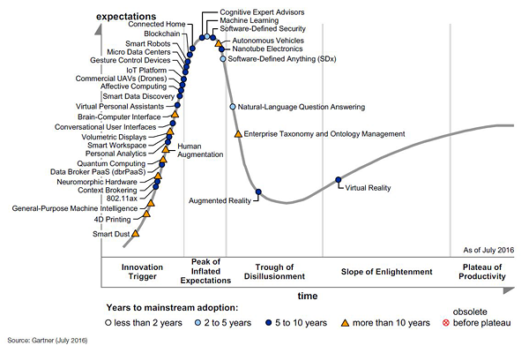
Need care to grow AGI technology
Machine learning
The investment phase of AGI is clearly different from the current ML investment
General-Purpose Machine Intelligence
Long-lasting is needed
(Gartner's Hype Cycle for Emerging Technologies, 2016)

Slide 35
Basic idea of WBAI
http://wba-initiative.org/en/2171/
Vision： Create a world in which AI exists in harmony with humanity.
Mission： Promote the open development of Whole Brain Architecture
‘to create a human-like AGI by learning from the architecture of the entire brain’
Values：
Study: Deepen and spread our expertise.
Imagine: Broaden our views through public dialogue.
Build: Create AGI through open collaboration.
Notes:
Direction of the whole brain architecture initiative (WBAI)
(Tentative translation version: March 14, 2017)
Our vision is to create a world in which AI exists in concord with humanity.
Our mission is to promote the open development of Whole Brain Architecture.
In order to make human-friendly artificial general intelligence a public good for all of mankind, we are constantly going to expand open co-creation on whole brain architectures.
We act valuing "studying, survey and synthesize".
Study: Learn expertise and propagate.
Survey: Deepen view through open dialogue
Synthesize: Create AI collaboratively.
WBAIの理念 (日本語版：2017年3月13日）
私たちのビジョンは、「人類と調和する人工知能のある世界」を実現することです
私たちのミッションは、「全脳アーキテクチャのオープンな開発を促進する」ことです
ヒューマン・フレンドリーな汎用人工知能を全人類の公共財とするために、脳全体に学んだアーキテクチャ上でのオープンな共創を継続的に拡大します
私たちは、「 まなぶ、みわたす、つくる」を価値として行動します
まなぶ： 関連分野の専門知識等を学び拡めてゆく
みわたす：広く未来の人類社会のありかたを対話を通じて見識を高めてゆく
つくる： 具体的な成果物を皆と共に作り上げてゆく

Slide 36


ELSI related activity of WBAI
SIG AI & society
Koichi Takahashi
Japanese Society for Artificial Intelligence
The Ethics Committee
Yutaka Matsuo
Vice-chair of WBAI
Vice-chair of WBAI
Several AI-related committees of Japanese government
・Yutaka Matsuo
・Koichi Takahashi
・Satoshi Kurihara
Future of Humanity Institute (FHI)

Slide 37
ELSI related activity of WBAI
SIG AI & society
Koichi Takahashi
Japanese Society for Artificial Intelligence
Artificial Intelligence Ethical Guidelines of the JSAI
The Chair, Yutaka Matsuo
1.Contribution to humanity
2. Abidance by the laws and regulations
3. Respect for the privacy of others
4. Fairness
5. Security
6. Act with integrity
7.Accountability and social responsibility
8. Communication with society and self-development
9. Abidance of ethics guidelines by AI
AI must abide by the policies described above in the same manner as the members of the JSAI in order to become a member or a quasi-member of society.
The Ethics Committee
Yutaka Matsuo
Vice-chair of WBAI
Vice-chair of WBAI
Several AI-related committees of Japanese government
・Yutaka Matsuo
・Koichi Takahashi
・Satoshi Kurihara
Future of Humanity Institute (FHI)

Slide 38

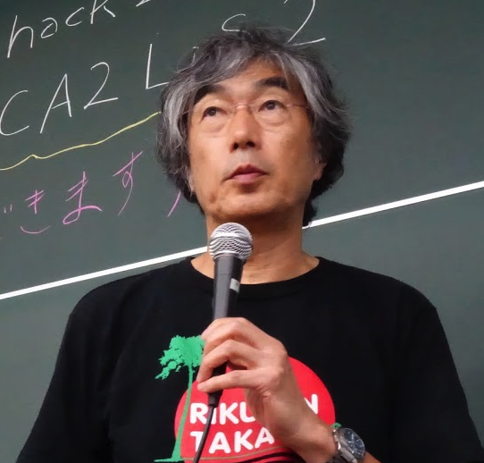
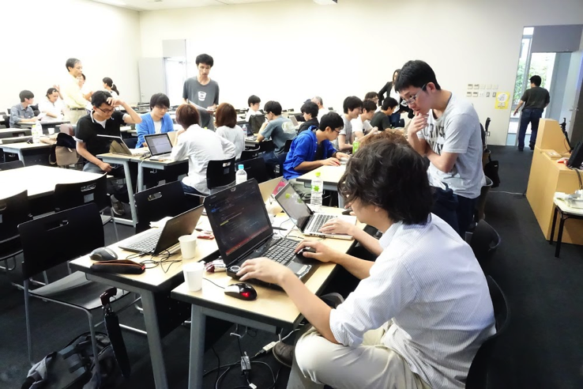
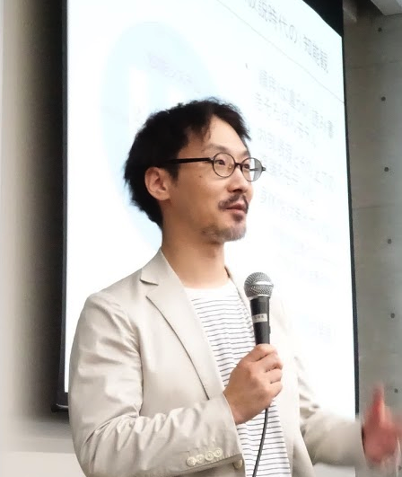
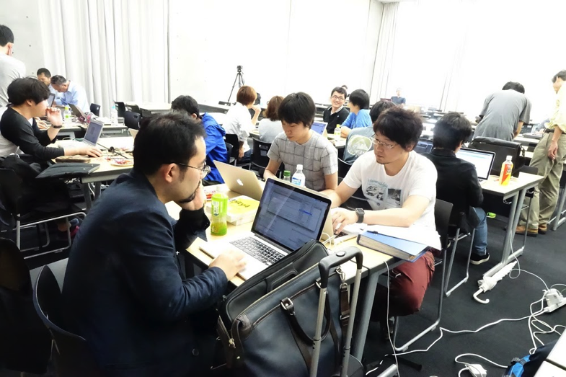
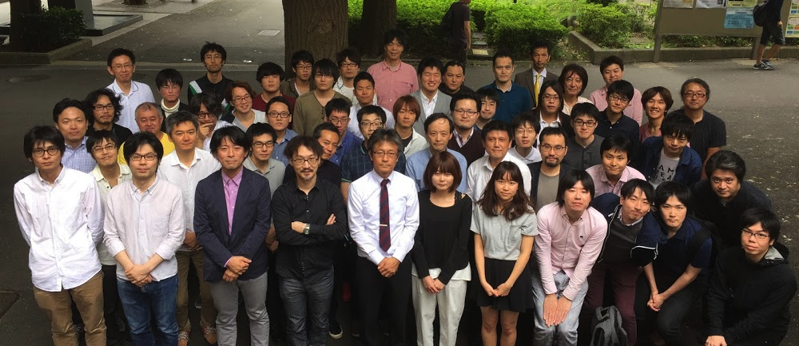




One of the major activity of WBAI
2nd WBA Hackathon, October 2016
【VIDEO】
Notes:
https://www.youtube.com/watch?v=lcoy6wIYY7c

Slide 39
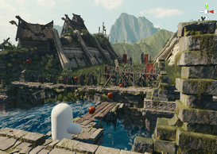

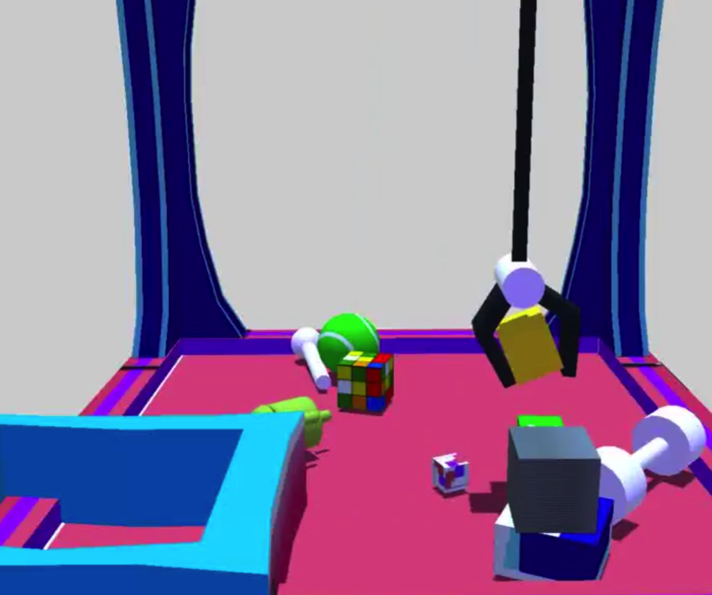
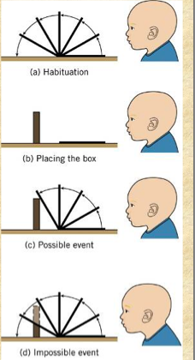
Democratization of AGI development with LIS
Environment simulator (Unity)
Machine learning
  Free to build a world, free of the game engine
  Various AI methods can be tried; DQN method is used as a standard equipment.
  Open platform Life in Silico (LIS)
  (April, 2016)
Ex. Learning intuition of physical world

Slide 40
Waiting for support for WBAI
Financial support
as a supporting member
Donation for
the WBAI Technology Encouragement Prize
Participation
in development as a volunteer
http://wba-initiative.org/support
http://wba-initiative.org/contact/
http://wba-initiative.org/sig-wba
Notes:
賛助会員として資金援助をしたい
WBAI技術奨励賞のために寄付したい
ボランティアとして開発に関わりたい
→賛助会員
戦略／国際化等に関わりたい→正会員

Slide 41
Today’s talk
Self-introduction
Whole brain architecture
Brain-inspired AI in harmony with humanity
Conclusions

Slide 42
Ways to construct a good superintelligence
Shared by everyone, not specific organizations
  Eg., Asilomar AI Principles 23) Common Good:
Thinking/behaving like a human being
  E.g. Asilomar AI Principles 10) Value Alignment:
It can be promoted by an open development of the brain architecture
We can build an intelligence similar to a human guided by neuroscientific knowledge
Notes:
Even if AGI goes beyond our intelligence, it will be relatively easy to understand it if it operates on the same architecture as our brain.
AGI based on the brain architecture will more likely be a common property of mankind,
because the architecture can be agreed upon by many
be used in a widely shared development platform.

Slide 43
Just before AGI comes true
What should we consider before really building an AGI?
Cannot identify who will be the winner
  Organized research team
  A genius inspiration in a corner of the world
  Open collaboration
What really happen in that moment?
  Recursive intelligence explosion like SF
  Gentle continual change
If you complete the AGI tomorrow, how should you act?
  Who should you consult with?
  Should it be published immediately?
Our WBAI was founded in 2015 to promote the completion of AGI in 2030 with open collaboration.
  In the future, we can also contribute to help spreading the completed AGI technology in a safe manner.
Researchers who are candidates of pioneer need to understand the impact of AGI well and know in advance how to convey it to the world properly.
Notes:
パイオニアになりうる人材はAGIのインパクトをよく理解し、それをどのように世界に伝えるべきかを事前に決めておく必要がある
スーパーエンジニアの意識を高めておくのは大事
管理されている
ーーー
本当にAGI出現することを踏まえ何を考えておくべきか？
誰が最初にAGIを完成されるかは特定できない
組織化された研究チーム
世界の片隅での天才のひらめき
共創開発
AGI完成が完成する瞬間
SFのように、再帰的な知能爆発がおこるのか
穏やかな変化が続くのか
もし明日、自分がAGI完成したら、いかに行動すべきか？
相談すべき相手は誰か？
速やかに公開すべきだろうか？
WBAIは、開かれた協創をによる２０３０年AGI完成を促進しするために2015年に創設した。
安全な形でAGI技術を広めることが、WBAIは、の役割になる可能性もあるだろう。

Slide 44
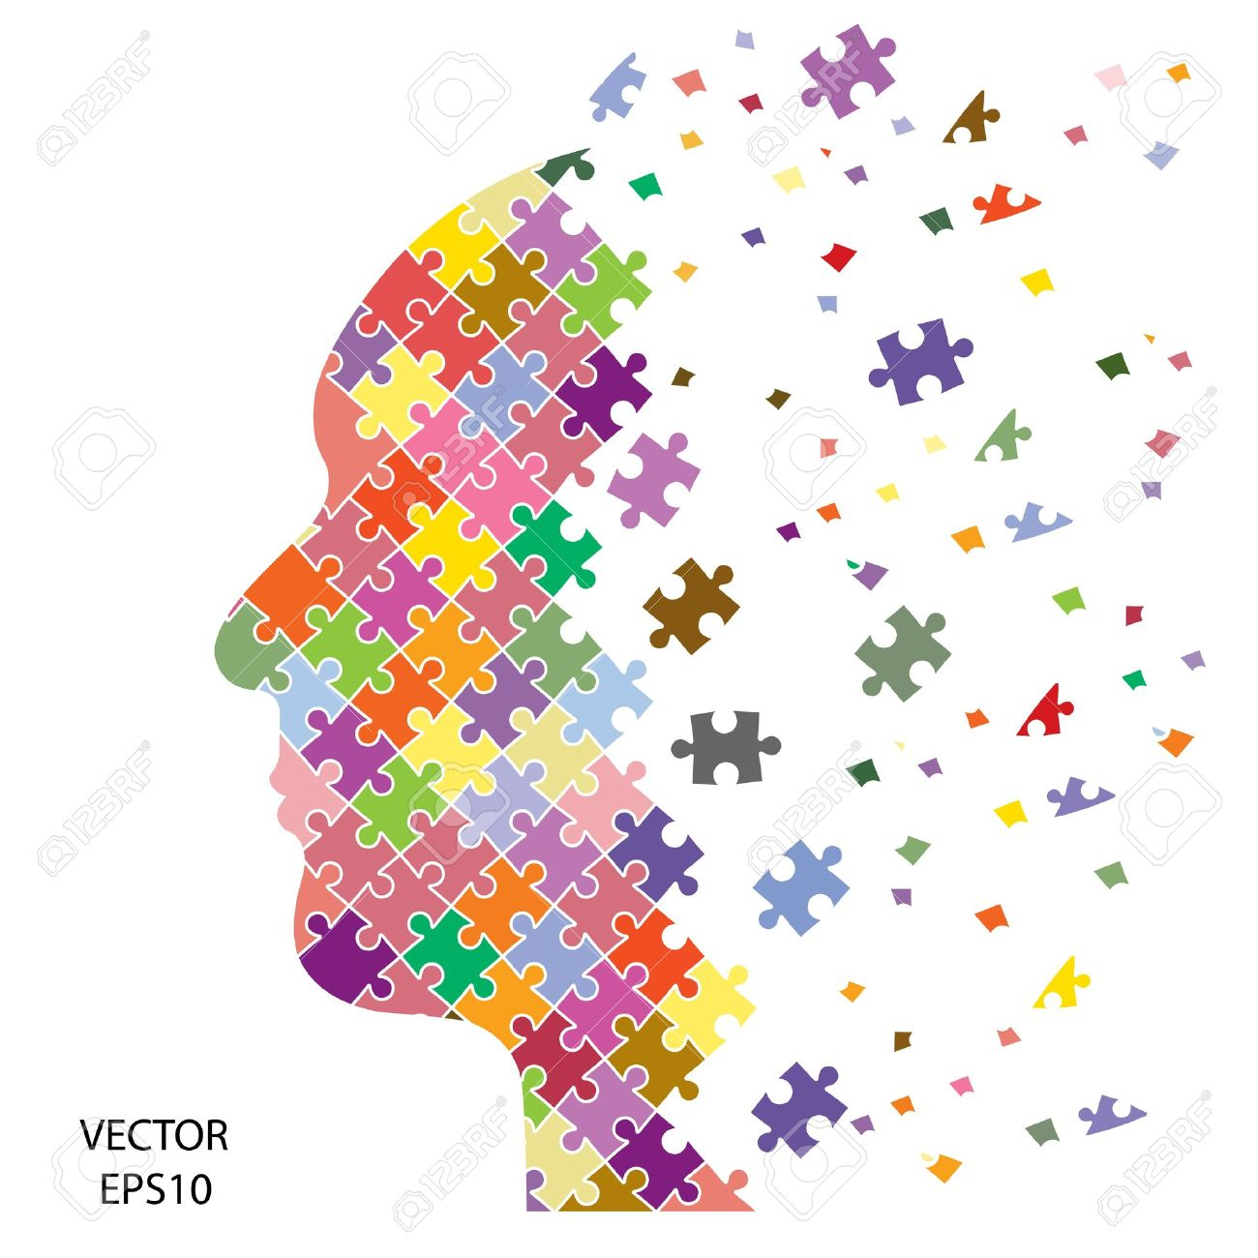
Neuroscience support story of AGI
We are on the way of solving the jigsaw puzzle
Steadily build up from the periphery
→ Neuroscience
Finding meaningful links
→ AI story (constructive approach)

Slide 45
At the end
Open co-creation of AGI guided by brain can be beneficial for humanity.
Collaboration of neuroscientist and AI researcher have been and become to be more meaningful.
Notes:
Here today can be the ignition origin of new collaborative movement/trend.
私たちは、脳に学びながらオープンにAGIを構築することが人類にとって有益と考える。
それゆえ今、そうした世界的な潮流を立ち上げることが必要ではないだろうか。
私達WBAIはこうした動きに貢献したいと考えている。

