Slide 1


Gatsby-Kaken Joint Workshop on AI and Neuroscience: May 11-12, 2017
Active inference and artificial curiosity
Karl Friston, University College London
Abstract: This talk offers a formal account of insight and learning in terms of active (Bayesian) inference. It deals with the dual problem of inferring states of the world and learning its statistical structure. In contrast to current trends in machine learning, we focus on how agents learn from a small number of ambiguous outcomes to form insights. I will present simulations of abstract rule-learning and approximate Bayesian inference to show that minimising (expected) free energy leads to active sampling of novel contingencies. This epistemic, curious, novelty-seeking behaviour closes ‘explanatory gaps’ in knowledge about the causal structure of the world, in addition to resolving uncertainty about states of the known world. We then move from inference to model selection or structure learning to show how abductive processes emerge when agents test plausible hypotheses about symmetries in their generative models. The ensuing Bayesian model reduction evokes mechanisms that have all the hallmarks of ‘aha moments’.
Key words: active inference ∙ insight ∙ novelty ∙ curiosity ∙ model reduction ∙ free energy ∙ epistemic value ∙ structure learning

Slide 2
A game (abstract rule)
Your prior beliefs:
You will choose the correct colour based on the three large circles.
The location of the correct colour depends upon the colour of the top circle.

Slide 3
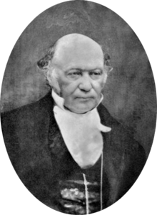
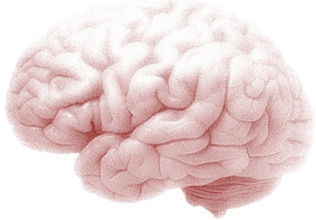
Active inference
Action and the path of least resistance
Generative models and active inference
From principles to process theories
Some empirical predictions
Artificial insight and aha moments

Slide 4
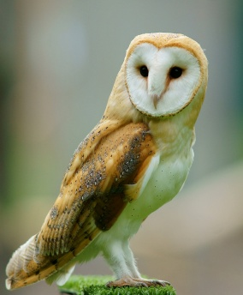


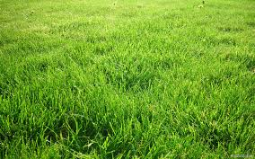
Imagine you are an owl – and you are hungry…

Slide 5
Optimal action depends on states of the world
Optimal action depends on beliefs about states
and subsequent action
Bellman’s Optimality Principle:
Optimal control theory
Dynamic programming
Reinforcement learning and expected utility
Backwards induction
State-action policy iteration
MDP
….
Hamilton's Principle of least Action:
Free energy principle
Active inference
Artificial curiosity and intrinsic motivation
Bayesian decision theory
Bayesian sequential policy optimisation
POMDP
….

Slide 6

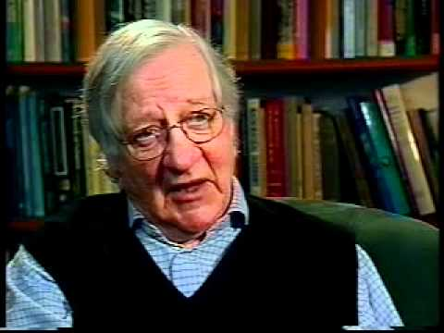
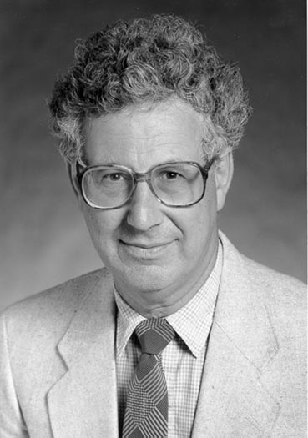
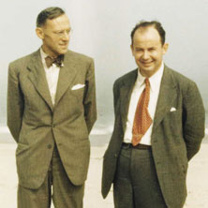
Prior beliefs about policies
Cost of a policy = expected free energy
Extrinsic value
Epistemic value or information gain
Bayesian surprise and Infomax
Flat prior beliefs about outcomes:
KL or risk-sensitive control
In the absence of ambiguity (known states):
Expected utility theory
In the absence of uncertainty or risk:
Bayesian surprise
Expected value
Predicted divergence
Mutual information

Slide 7
Overview
Action and the path of least resistance
Generative models and active inference
From principles to process theories
Some empirical predictions
Artificial insight and aha moments

Slide 8
A (Markovian) generative model
Likelihood
Empirical priors – hidden states
Precision
– control states
Policy
Full priors
Hidden states
Approximate posterior

Slide 9
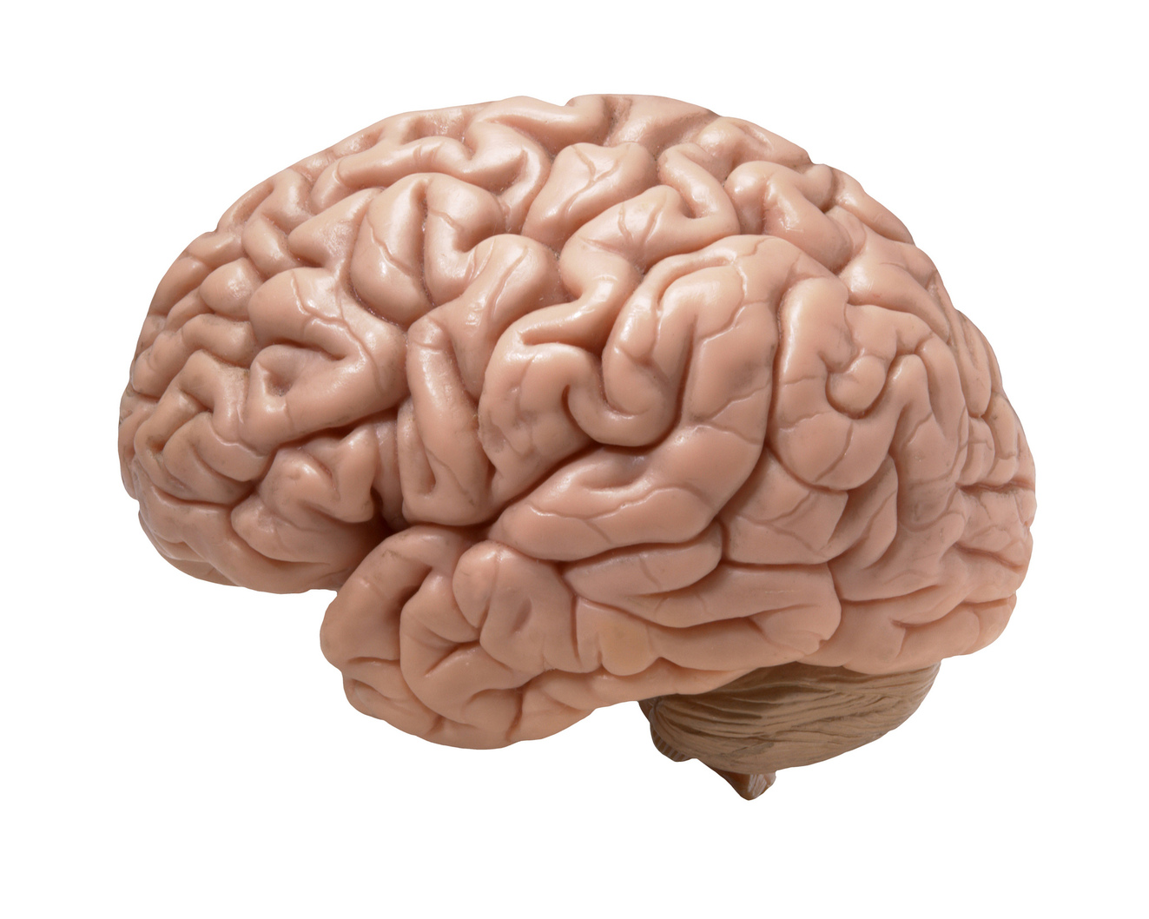
Variational updates
Functional anatomy
Perception
Action selection
Incentive salience
motor Cortex
striatum
occipital Cortex
prefrontal Cortex
Performance
hippocampus
FE
VTA/SN
80
KL
RL
60
DA
success rate (%)
40
20
0
0
0.2
0.4
0.6
0.8
1
Prior preference
Simulated behaviour
Action selection

Slide 10
Predicted action
Dorsal prefrontal
Motor Cortex
Bayesian model average of next state
Policy
selection
Precision
Striatum & VTA/SN
Evaluation of policies
State estimation under plausible policies
Sensory input
Ventral prefrontal
Hippocampus
Occipital Cortex

Slide 11

Two-step maze task
Control states
Generative model
1 2 3 4
location
US
US
Hidden states
CS
location
context
Outcomes

Slide 12


Initial state and policy selection
2
US
Policy
4
US
6
8
10
5
10
15
20
25
30
Trial
Final outcome, performance and reaction times
4
2
Expected utility
CS
0
CS
-2
5
10
15
20
25
30
State estimation (ERPs)
0.2
Response
0
-0.2
200
400
600
800
1000
1200
1400
Precision (dopamine)
1
0.5
Precision
0
-0.5
200
400
600
800
1000
1200
1400
Learning (C and D)
2
4
Hidden state
6
8
5
10
15
20
25
30

Slide 13
Overview
Action and the path of least resistance
Generative models and active inference
From principles to process theories
Some empirical predictions
Artificial insight and aha moments

Slide 14
Variational updates
Functional anatomy
Functional anatomy
Perception
Action selection
Incentive salience
motor Cortex
motor Cortex
occipital Cortex
striatum
occipital Cortex
striatum
prefrontal Cortex
hippocampus
Performance
hippocampus
FE
VTA/SN
80
KL
VTA/SN
RL
60
DA
success rate (%)
40
20
0
0
0.2
0.4
0.6
0.8
1
Prior preference
Simulated behaviour

Slide 15
US
Initial state and policy selection
2
Policy
4
6
8
10
5
10
15
20
25
30
CS
Trial
Final outcome, performance and reaction times
4
2
Expected utility
0
-2
5
10
15
20
25
30
Inference
(state estimation)
State estimation (ERPs)
0.2
Response
0
-0.2
200
400
600
800
1000
1200
1400
Precision (dopamine)
Policy selection
1
0.5
Precision
0
-0.5
200
400
600
800
1000
1200
1400
Learning (D)
2
4
Hidden state
6
Learning
8
5
10
15
20
25
30

Slide 16
Overview
Action and the path of least resistance
Generative models and active inference
From principles to process theories
Some empirical predictions
Artificial insight and aha moments

Slide 17

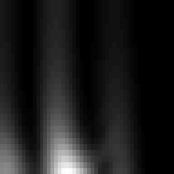
Unit responses
Evidence accumulation
Phase precession
Place cell activity
Oddball (MMN) responses
Dopamine transfer
Firing rates
US
1
8
0.8
unit
0.6
Chosen option
Response
16
0.4
Unchosen
0.2
CS
24
0
0.25
0.5
0.75
0.25
0.5
0.75
time (seconds)
time (seconds)
Time-frequency response
Local field potentials
30
0.12
25
0.1
Phase precession
20
0.08
frequency
0.06
Response
15
0.04
10
0.02
5
0
0.25
0.5
0.75
-0.02
0.25
0.5
0.75
time (seconds)
time (seconds)
Phasic dopamine responses
0.5
US
0.4
0.3
0.2
change in precision
0.1
0
-0.1
CS
-0.2
10
20
30
40
time (updates)

Slide 18
Evidence accumulation
Phase precession
Place cell activity
Oddball (MMN) responses
Dopamine transfer
Expectations about the past (memory)
Unit responses
8
unit
16
1
2
3
24
0.25
0.5
0.75
Expectations about the future (planning)
time (seconds)

Slide 19


Repetition suppression and DA transfer
Evidence accumulation
Phase precession
Place cell activity
Oddball (MMN) responses
Dopamine transfer
8
unit
16
24
0.25
0.5
0.75
1
1.25
1.5
time (seconds)
Time-frequency response
30
25
Difference waveform (MMN)
20
frequency
0.08
15
10
0.06
5
oddball
0.25
0.5
0.75
1
1.25
1.5
0.04
time (seconds)
Local field potentials
LFP
0.02
standard
0.05
0
Response
0
-0.02
MMN
-0.05
-0.04
-0.06
0.25
0.5
0.75
1
1.25
1.5
50
100
150
200
250
300
350
time (seconds)
Time (ms)
Phasic dopamine responses
0.5
US
oddball
standard
change in precision
0
-0.5
10
20
30
40
50
60
70
80
90
time (updates)
CS

Slide 20
Overview
Action and the path of least resistance
Generative models and active inference
From principles to process theories
Some empirical predictions
Artificial insight and aha moments

Slide 21
A game (abstract rule)
Your prior beliefs:
You will choose the correct colour indicated by the large circles.
The location of the correct colour depends upon the colour of the upper circle.
…..

Slide 22







Our game
Hidden states
rule
colour
where
centre
left
start
right
left center right
Priors
choice
r
g
b
r
g
b
r
what
g
b
r
g
b
r
g
b
r
g
b
Correct color
Correct color
where
centre
left
start
right
feedback
Outcomes

Slide 23

Rule learning
Initial state and policy selection
Policy
2
4
6
5
10
15
20
25
30
Final outcome and performance
5
Expected utility
0
-5
5
10
15
20
25
30
Free energy
34
nats
32
30
28
26
5
10
15
20
25
30
Confidence
nats
-6.5
-7
-7.5
5
10
15
trial
20
25
30

Slide 24




Epistemic learning and novelty
Hidden states - rule
Inferred and selected action - where
Hidden states - rule
Inferred and selected action - where
1
1
1
1
2
2
3
1
2
3
4
5
6
2
3
1
2
3
4
5
6
2
action
action
Hidden states - colour
3
Hidden states - colour
3
1
4
1
4
2
2
3
1
2
3
4
5
6
1
2
3
4
5
3
1
2
3
4
5
6
1
2
3
4
5
Hidden states - where
Inferred and selected action - choice
Hidden states - where
Inferred and selected action - choice
2
1
2
1
4
1
2
3
4
5
6
2
4
1
2
3
4
5
6
2
action
action
Hidden states - choice
3
Hidden states - choice
3
2
4
2
4
4
1
2
3
4
5
6
1
2
3
4
5
4
1
2
3
4
5
6
1
2
3
4
5
time
time
time
time

Slide 25
Expected free energy and novelty
So far, we have considered expected free energy in terms of risk and ambiguity that reflect uncertainty about states. Exactly the same principles can be applied to model parameters leading to epistemic policies that resolve ignorance; i.e., search out novel contingencies.
novelty
intrinsic value
extrinsic
ignorance
risk
ambiguity

Slide 26


The neural correlates of insight
A
B
Unit responses
Firing rates
Unit responses
Firing rates
1
1
3
past
0.8
3
0.8
6
0.6
6
0.6
unit
9
Response
unit
9
Response
0.4
12
0.4
12
0.2
0.2
15
future
15
18
0
18
0
0.25
0.5
0.75
1
1.25
1.5
0.25
0.5
0.75
1
1.25
1.5
0.25
0.5
0.75
1
1.25
1.5
0.25
0.5
0.75
1
1.25
1.5
time (seconds)
time (seconds)
time (seconds)
time (seconds)
trial 1
Local field potentials
trial 31
0.2
Local field potentials
0.2
0.15
0.15
0.1
0.1
Response
0.05
0.05
0
0
-0.05
-0.05
-0.1
0.25
0.5
0.75
1
1.25
1.5
-0.1
0.25
0.5
0.75
1
1.25
1.5
time (seconds)
time (seconds)

Slide 27
Bayes optimal rule learning?
Initial state and policy selection
Policy
2
4
6
5
10
15
20
25
30
Final outcome and performance
5
Expected utility
0
-5
5
10
15
20
25
30
Free energy
34
nats
32
30
28
26
5
10
15
20
25
30
Confidence
nats
-6.5
-7
-7.5
5
10
15
trial
20
25
30

Slide 28
Bayesian model reduction and insight
So far, we have considered optimising expectations about states and parameters ; however, we can also optimise the model itself with respect to free energy. This is known as Bayesian model comparison or reduction that can proceed in the absence of new information. For example, the awake brain learns causal associations in synaptic connections, while during sleep redundant connections are removed (Tononi and Cirelli, 2006) to minimise complexity (Hobson and Friston, 2012) – literally to ‘clear one's mind’. Here, plausible models are implicitly defined under the prior belief that there is a rule (i.e. a symmetry or invariance of contingencies in the likelihood mapping)
By applying Bayes rules to the full and reduced models it is straightforward to show that the change in free energy can be expressed in terms of posterior concentration parameters a, prior concentration parameters a and the prior concentration parameters that define a reduced or simpler model a’:
This equation returns the difference in free energy we would have observed, had we started observing outcomes with simpler prior beliefs.

Slide 29


Insight and model reduction
Sample: left - center - right
Priors
r
g
b
r
Rule: right - center - left
g
b
r
g
b
r
g
b
r
g
b
r
g
b
Correct color
Correct color
Posteriors
Reduced
Correct color
Correct color

Slide 30
The emergence of insight
Without model reduction
With model reduction
64 subjects

Slide 31
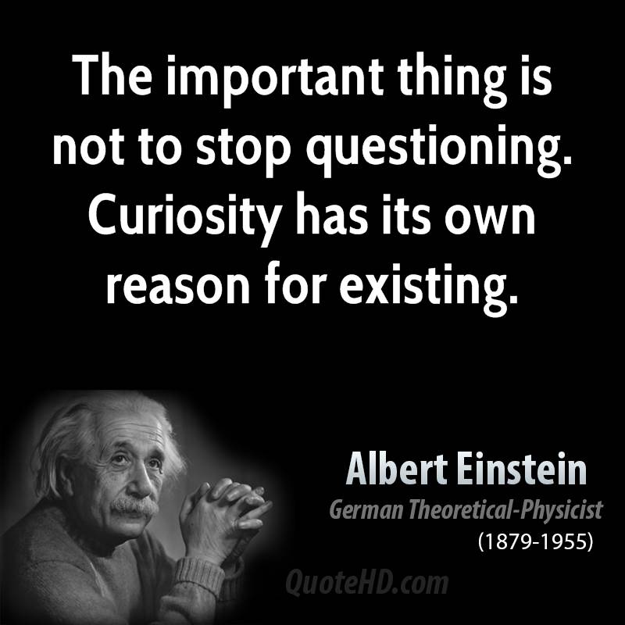

Slide 32
Thank you
And thanks to collaborators:
Rick Adams
Ryszard Auksztulewicz
Andre Bastos
Sven Bestmann
Harriet Brown
Jean Daunizeau
Mark Edwards
Chris Frith
Thomas FitzGerald
Xiaosi Gu
Stefan Kiebel
James Kilner
Christoph Mathys
Jérémie Mattout
Rosalyn Moran
Dimitri Ognibene
Sasha Ondobaka
Will Penny
Giovanni Pezzulo
Lisa Quattrocki Knight
Francesco Rigoli
Klaas Stephan
Philipp Schwartenbeck
And colleagues:
Micah Allen
Felix Blankenburg
Andy Clark
Peter Dayan
Ray Dolan
Allan Hobson
Paul Fletcher
Pascal Fries
Geoffrey Hinton
James Hopkins
Jakob Hohwy
Mateus Joffily
Henry Kennedy
Simon McGregor
Read Montague
Tobias Nolte
Anil Seth
Mark Solms
Paul Verschure
And many others

